Slide 1

2024년도 1학기
인공지능
Artificial Intelligence

Slide 2
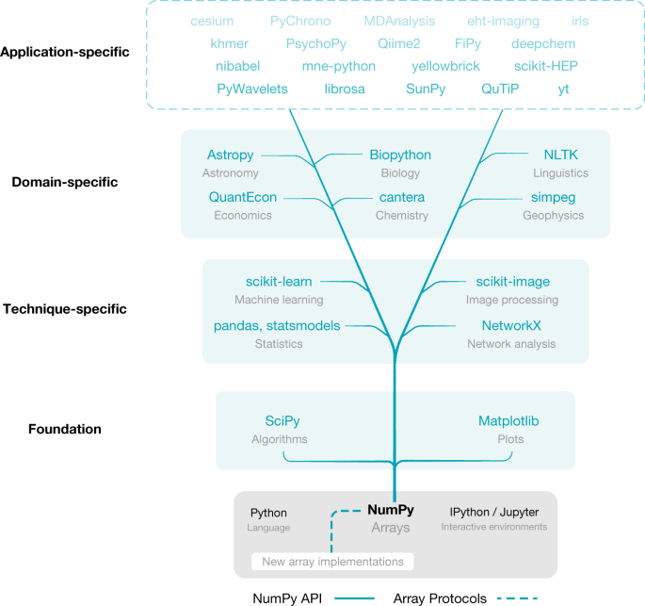
In Last Lecture
Numpy 중요성

Slide 3
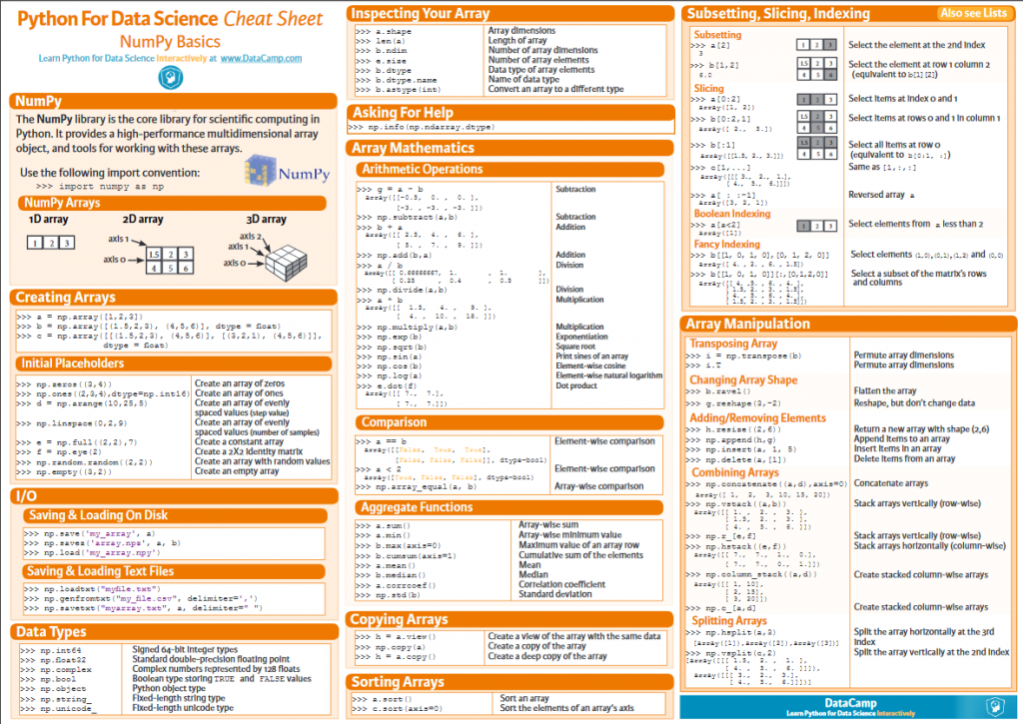
In Last Lecture

Slide 4
Pandas
04
What is Pandas?
Pandas Data Structure
Data processing in Pandas
Data preprocessing

Slide 5
What is Pandas?
A

Slide 6

What is Pandas?
An open-source library that is built on top of NumPy library
One of the most popular Python libraries for data science
Data read, data cleaning, data transforming, and data analysis
Notes:
NumPy 라이브러리 기반으로 구축된 오픈 소스 라이브러리
데이터 과학을 위한 가장 인기 있는 Python 라이브러리 중 하나
데이터 읽기, 데이터 정리, 데이터 변환 및 데이터 분석

Slide 7
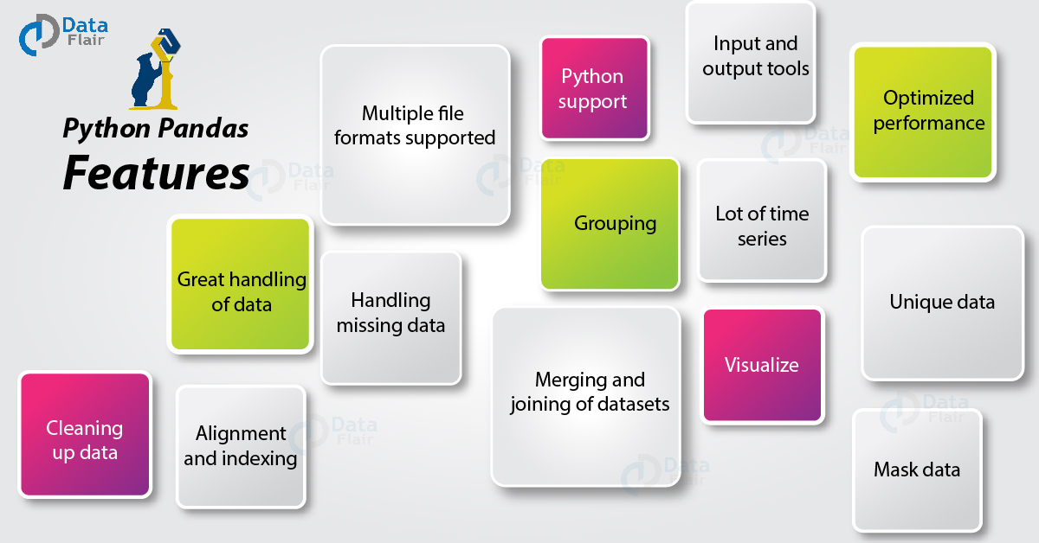
What is Pandas?
Pandas features

Slide 8
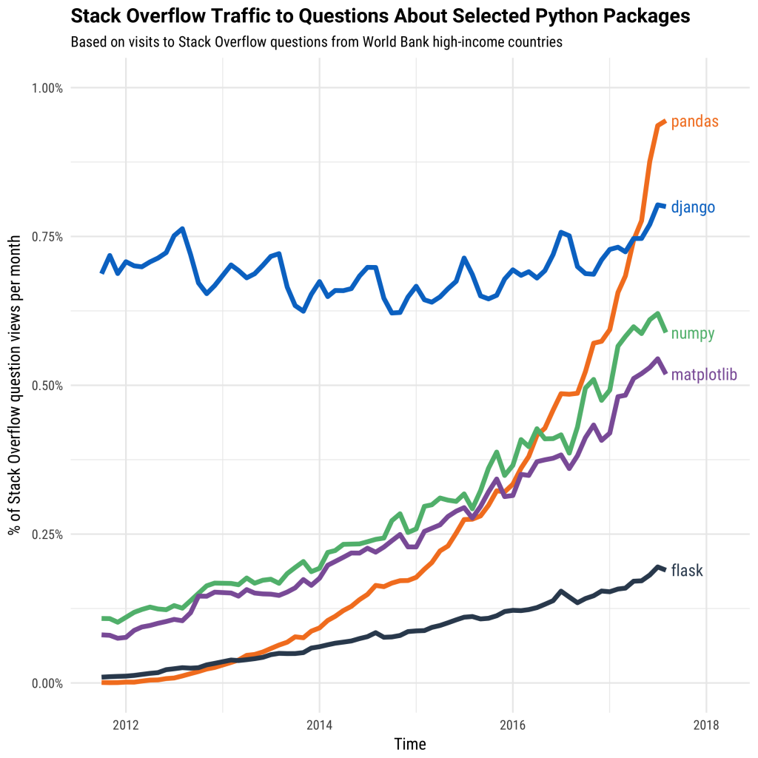
What is Pandas?
Why Pandas?

Slide 9
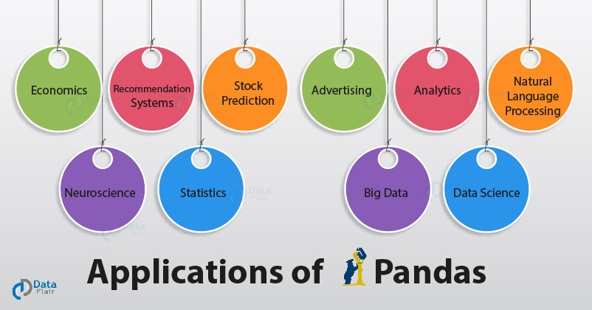
What is Pandas?
Pandas Application areas

Slide 10
What is Pandas?
Jupyter Notebook을 실행
명령 프롬프트(CMD)를 실행하고 다음 명령어를 입력
pip install pandas
다른 라이브러리 또한 설치해야 함
Numpy
pandas 라이브러리 버전 확인
import pandas #Importing pandas library
print(pandas.__version__) #Printing pandas library version

Slide 11
Pandas Data Structure
B

Slide 12
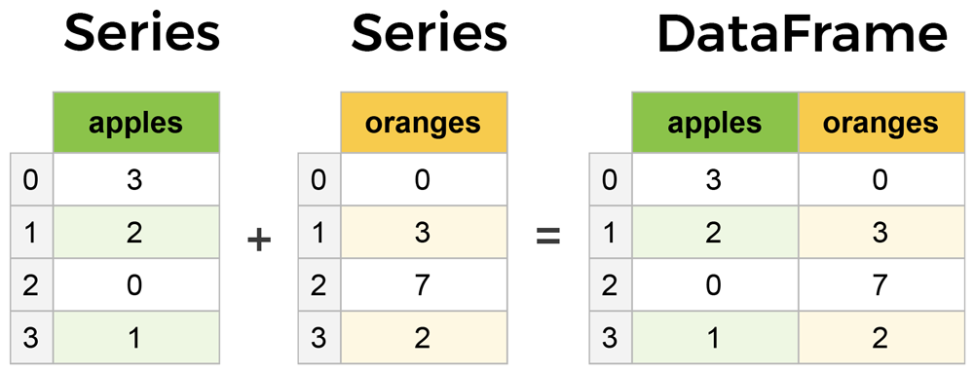
Pandas Data Structure
Pandas의 두 가지 주요 구성 요소는 Series와 DataFrame이다
Series
A column
Data frame
Series 컬렉션으로 구성된 다차원 테이블

Slide 13
Pandas Data Structure
Series
레이블이 지정된 일차원 배열
Syntax
pandas.Series(data, index, dtype, copy)
data
Input data in the form of ndarray, list, dict or scalar value
index
Index of the column
dtype
Data type
copy
Copy data

Slide 14
Pandas Data Structure
Series
Numpy를 이용한 Series 만드는 방법
import pandas as pd
import numpy as np
data = np.array(['a','b','c','d'])
series = pd.Series(data, index=[100,101,102,103])
print(series)
100 a
101 b
102 c
103 d
dtype: object

Slide 15
Pandas Data Structure
Series
dict를 이용한 Series 만드는 방법
import pandas as pd
import numpy as np
data = {100 : 'a', 101 : 'b', 102 : 'c', 103 : 'd'}
series = pd.Series(data)
print(series)
100 a
101 b
102 c
103 d
dtype: object
Notes:
딕셔너리
Key와 value과 하나의 쌍을 이루는 데이터 타입

Slide 16
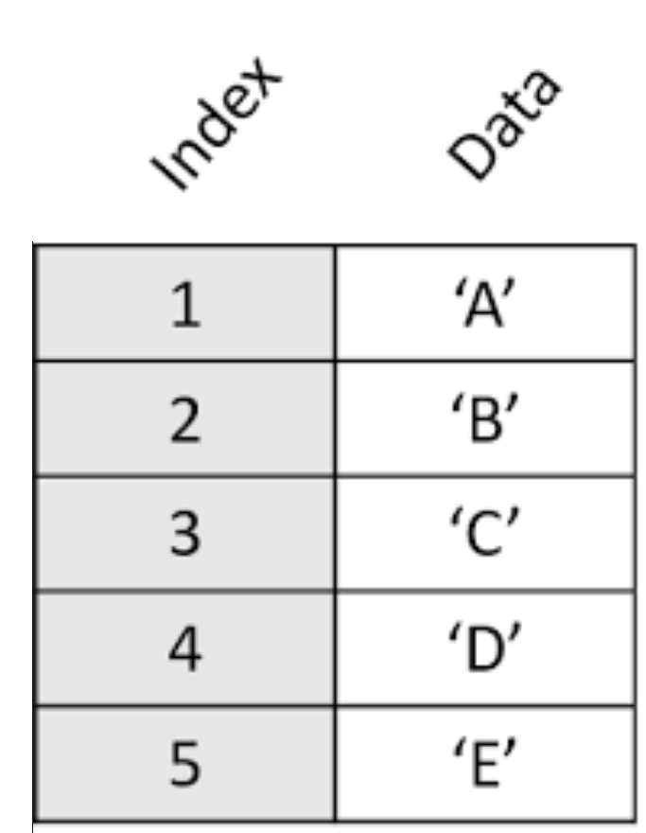
Pandas Data Structure
Series
Task: Create a series for the following column

Slide 17
Pandas Data Structure
Series
Task: Create a series for the following column
import pandas as pd
import numpy as np
data = np.array(['A','B','C','D', 'E'])
series = pd.Series(data, index=[1,2,3,4, 5])
print(series)
1 A
2 B
3 C
4 D
5 E
dtype: object

Slide 18
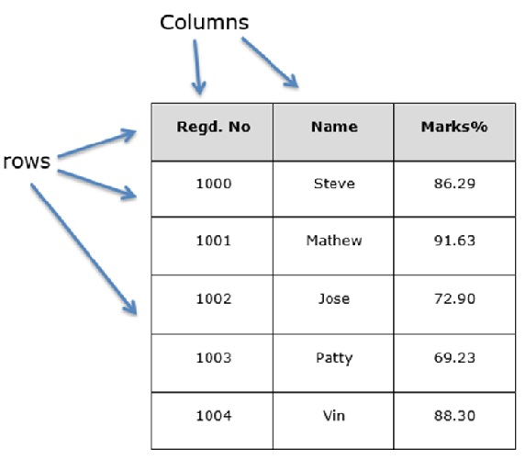
Pandas Data Structure
Data frame
행과 열로 구성된 다차원 테이블

Slide 19
Pandas Data Structure
Data frame
Syntax
pandas.DataFrame(data, index, columns, dtype, copy)
data
Input data in the form of series, ndarray, list, dict or scalar value
index
Index of the data frame
columns
Name/label of columns
dtype
Data type
copy
Copy data

Slide 20
Pandas Data Structure
Data frame
List를 이용한 data frame 만드는 방법
import pandas as pd
data = [['Tim',35],['Sonya',30],['Sunny',34]]
df = pd.DataFrame(data,columns=['Name','Age'],dtype=float)
print(df)
Name Age
0 Tim 35.0
1 Sonya 30.0
2 Sunny 34.0

Slide 21
Pandas Data Structure
Data frame
Dict of series를 이용한 data frame 만드는 방법
import pandas as pd
data = {'one' : pd.Series([1, 2, 3], index=['a', 'b', 'c']),
'two' : pd.Series([1, 2, 3, 4], index=['a', 'b', 'c', 'd'])}
df = pd.DataFrame(data)
print(df)
one two
a 1.0 1
b 2.0 2
c 3.0 3
d NaN 4

Slide 22
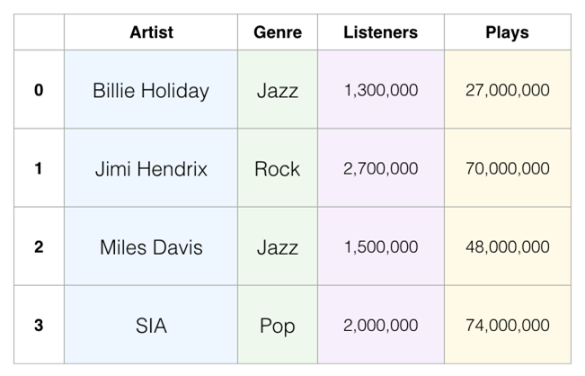
Pandas Data Structure
Data frame
Dict of series를 사용하여 다음 테이블에 대한 data frame 만들어보기

Slide 23
Pandas Data Structure
Data frame
dict of series를 사용하여 다음 테이블에 대한 data frame 만들어보기
import pandas as pd
import numpy as np
data = {'Artist' : pd.Series(['Billie Holiday', 'Jimi Hendrix', 'Miles Davis', 'SIA']),
'Genre' : pd.Series(['Jazz', 'Rock', 'Jazz', 'Pop']),
'Listeners' : pd.Series([1300000, 2700000, 1500000, 2000000]),
'Plays' : pd.Series([27000000, 70000000, 48000000, 74000000])}
df = pd.DataFrame(data)
print(df)

Slide 24
실습
앞선 예제의 코드를 실행해보고 이해해보자

Slide 25
Data Processing in Pandas
C

Slide 26
Data Processing in Pandas
Pandas의 read_csv 함수를 이용하여 데이터 볼러오기
Save IMDB-Movie-Data.csv file in your local storage
index_col 속성
CSVs don't have indexes like our Data Frames, so all we need to do is just designate the index_col when reading
In our case, we select “Title” column as index
import pandas as pd
movies_df = pd.read_csv(r"D:/IMDB-Movie-Data.csv", index_col="Title")
print(movies_df)

Slide 27
Data Processing in Pandas
head() 함수
Print out a first five rows of your data frame
movies_df.head()
We could also pass a number to head()
movies_df.head(10)
tail() 함수
Print out the last five rows
movies_df.tail()
If you want to see the last two records, then pass a number
movies_df.tail(2)

Slide 28
Data Processing in Pandas
info()
Provides essential details about your dataset
Features
Number of rows
Number of columns
Number of non-null values
Type of data in each column
How much memory the data frame is using

Slide 29
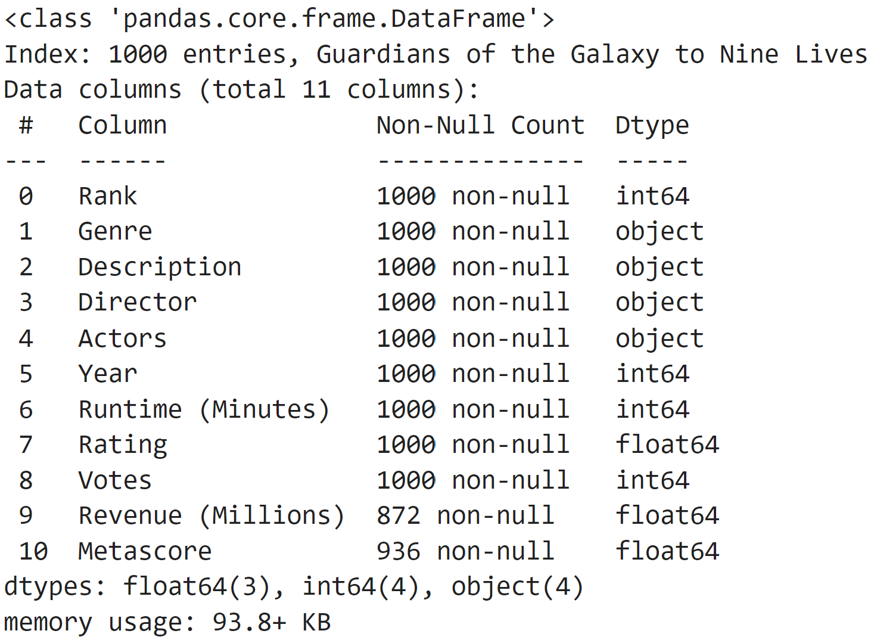
Data Processing in Pandas
info()
movies_df.info()

Slide 30
Data Processing in Pandas
shape
행과 열의 크기
movies_df.shape
(1000, 11)
Used frequently when cleaning and transforming data
예를 들어 일부 기준에 따라 일부 행을 필터링한 다음 제거된 행 수를 빨리 알고 싶을 경우

Slide 31
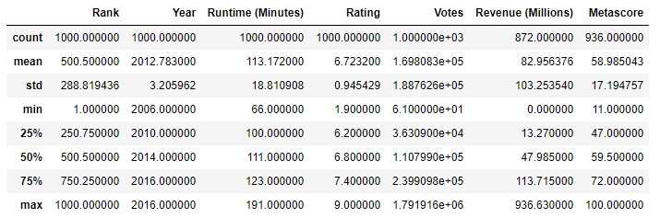
Data Processing in Pandas
describe()
Returns descriptive and summary statistics about dataframe
describe function for continuous variables
movies_df.describe()
1.count : 개수
2.mean : 평균
3.std : 표준편차
4.min, max : 최솟값, 최댓값
5.25%, 50%, 75% -> 4분위수 (25% -> 25%의 데이터들이 해당 값보다 낮다)
Notes:
데이터프레임에 대한 설명해줌. 요약 통계를 반환합니다.

Slide 32
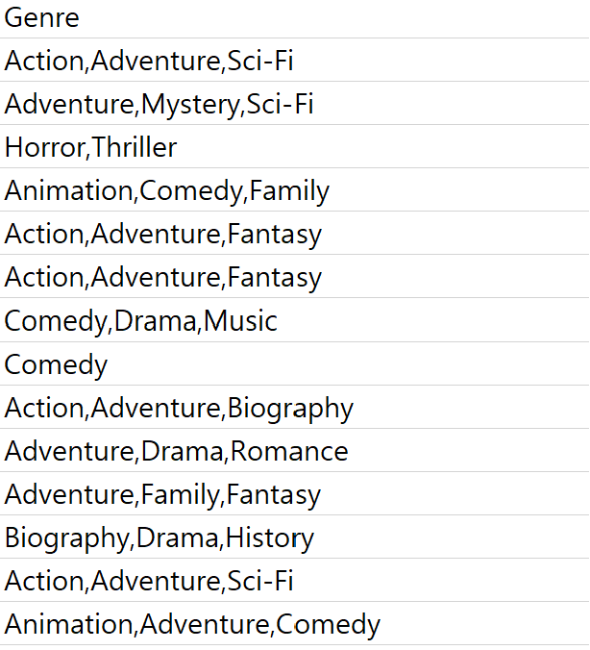
Data Processing in Pandas
describe()
We can also use describe() function for categorical variables
movies_df['Genre'].describe()
Features
count of rows
unique count of categories
top category
freq of top category
count 1000
unique 207
top Action,Adventure,Sci-Fi
freq 50
Name: Genre, dtype: object
데이터 셋에서 총 50번 나옴

Slide 33
Data Processing in Pandas
columns
데이터 셋의 열 이름을 반환
movies_df.columns
columns를 통해 열 이름을 변경 할 수 있음
Index(['Rank', 'Genre', 'Description', 'Director', 'Actors', 'Year',
'Runtime (Minutes)', 'Rating', 'Votes', 'Revenue (Millions)',
'Metascore'],
dtype='object')c

Slide 34
Data Processing in Pandas
index
데이터 세트의 인덱스를 출력
movies_df.index
Index(['Guardians of the Galaxy', 'Prometheus', 'Split', 'Sing',
'Suicide Squad', 'The Great Wall', 'La La Land', 'Mindhorn',
'The Lost City of Z', 'Passengers',
...
'Underworld: Rise of the Lycans', 'Taare Zameen Par',
'Take Me Home Tonight', 'Resident Evil: Afterlife', 'Project X',
'Secret in Their Eyes', 'Hostel: Part II', 'Step Up 2: The Streets',
'Search Party', 'Nine Lives'],
dtype='object', name='Title', length=1000)

Slide 35
Data Processing in Pandas
rename()
dict을 통해 특정 또는 모든 열의 이름을 변경 할 수 있음
Task
Change Revenue (Millions) -> 'Revenue_millions'
movies_df.rename(columns={
'Runtime (Minutes)': 'Runtime',
}, inplace=True)
movies_df.columns
Index(['Rank', 'Genre', 'Description', 'Director', 'Actors', 'Year',
'Runtime','Rating', 'Votes', 'Revenue (Millions)', 'Metascore'],
dtype='object')

Slide 36
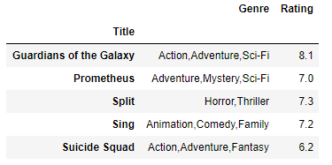
Data Processing in Pandas
Data frame manipulation
Output the following table
Note: Title is index variable
Source code
subset = movies_df[['Genre', 'Rating']]
subset.head()

Slide 37
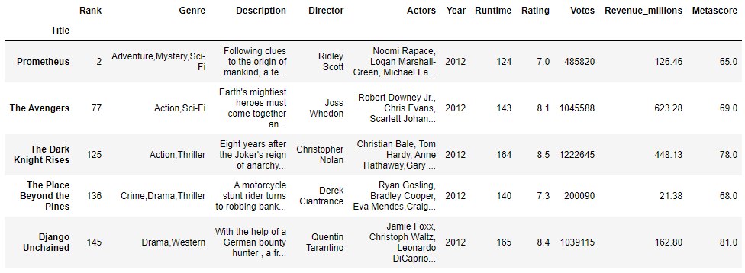
Data Processing in Pandas
Data frame manipulation
Output movies taken in 2012
movies_df[movies_df['Year'] == 2012].head(5)

Slide 38
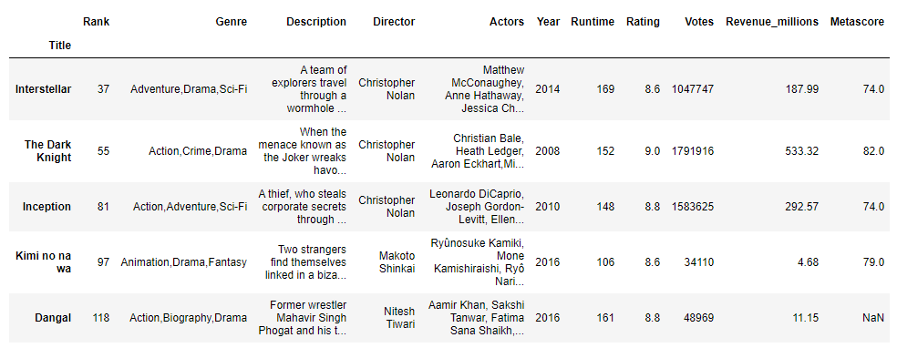
Data Processing in Pandas
Data frame manipulation
Output the movies that have a rating of 8.6
movies_df[movies_df['Rating'] >= 8.6].head(5)

Slide 39
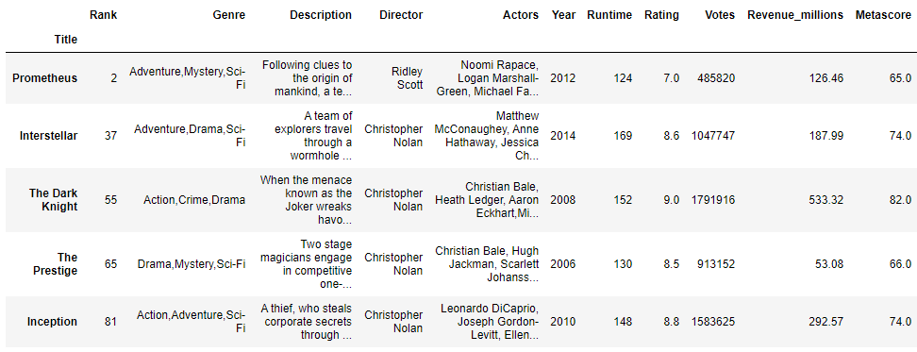
Data Processing in Pandas
Data frame manipulation
Output movies, which was directed by Christopher Nolan OR Ridley Scott
Hint we can use OR (|) operator
movies_df[(movies_df['Director'] == 'Christopher Nolan') |
(movies_df['Director'] == 'Ridley Scott')].head(5)

Slide 40
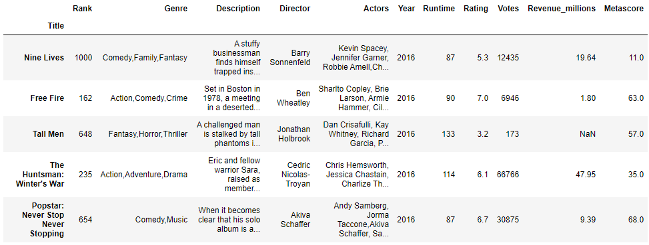
Data Processing in Pandas
Data frame manipulation
sort_value() function for sorting by values
“by” argument that indicates the column name of data frame to be sorted
Example of sort_value()
movies_df.sort_values(by='Year', ascending=False).head(5)

Slide 41
실습
앞선 예제의 코드를 실행해보고 이해해보자

Slide 42
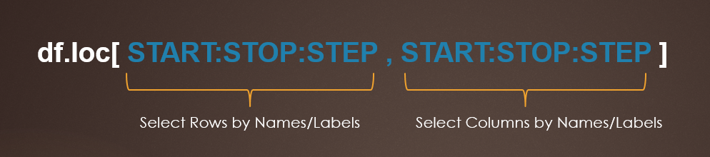
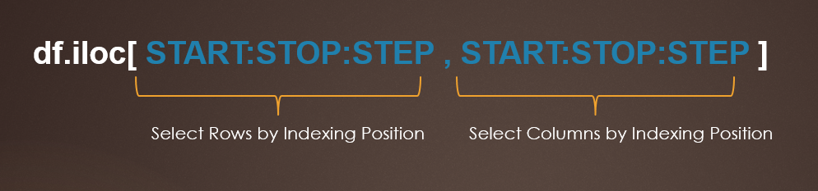
Data Processing in Pandas
Data frame manipulation
loc[] is used to select rows and columns by Names/Labels
iloc[] is used to select rows and columns by Integer Index/Position. zero based index position.
locate
Notes:
loc method allows you to locate data by row or column labels
loc 메소드를 사용하면 행 또는 열 레이블로 데이터를 찾을 수 있음

Slide 43
Data Processing in Pandas
loc[] and iloc[] examples
Let’s create the following DataFrame
# Pandas.DataFrame.iloc[] usage
import pandas as pd
technologies = {
'Courses':["Spark","PySpark","Hadoop","Python","pandas"],
'Fee' :[20000,25000,26000,22000,24000],
'Duration':['30day','40days','35days','40days','60days'],
'Discount':[1000,2300,1200,2500,2000]
}
index_labels=['r1','r2','r3','r4','r5']
df = pd.DataFrame(technologies,index=index_labels)
print(df)

Slide 44
Data Processing in Pandas
loc[] and iloc[] examples
Let’s create the following DataFrame
# Outputs:
# r1 Spark 20000 30day 1000
# r2 PySpark 25000 40days 2300
# r3 Hadoop 26000 35days 1200
# r4 Python 22000 40days 2500
# r5 pandas 24000 60days 2000

Slide 45
Data Processing in Pandas
loc[] and iloc[] examples
Select Single Value Using loc[] vs iloc[]
# Select Single Row by Index Label
print(df.loc['r2'])
# Select Single Row by Index
print(df.iloc[1])
지정한 하나의 행 출력 (r2)
지정한 하나의 행 출력 (1번째 인덱스)
# Outputs:
# Courses PySpark
# Fee 25000
# Duration 40days
# Discount 2300
# Name: r2, dtype: object

Slide 46
Data Processing in Pandas
loc[] and iloc[] examples
In order to select column by label and Index use below
# Select Single Column by label
print(df.loc[:, "Courses"])
# Select Single Column by Index
print(df.iloc[:, 0])
Courses 열의 전체 행 출력 (인덱스와 함께)
0번째 열의 전체 행 출력 (인덱스와 함께)
# Outputs:
# Courses
# r1 Spark
# r2 PySpark
# r3 Hadoop
# r4 Python
# r5 pandas

Slide 47
Data Processing in Pandas
loc[] and iloc[] examples
To select multiple rows and columns, use the labels or integer index as a list to loc[] and iloc[] attributes
# Select Multiple Rows by Label
print(df.loc[['r2','r3']])
# Select Multiple Rows by Index
print(df.iloc[[1,2]])
지정한 행 출력 (r2, r3)
지정한 행 출력 (1, 2번째 인덱스)
# Outputs:
# Courses Fee Duration Discount
# r2 PySpark 25000 40days 2300
# r3 Hadoop 26000 35days 1200

Slide 48
Data Processing in Pandas
loc[] and iloc[] examples
Similarly to select multiple columns from pandas DataFrame
# Select Multiple Columns by labels
print(df.loc[:, ["Courses","Fee","Discount"]])
# Select Multiple Columns by Index
print(df.iloc[:, [0,1,3]])
Courses, Fee, Discount 열의 전체 행 출력 (인덱스와 함께)
0, 1, 3번째 열의 전체 행 출력 (인덱스와 함께)
# Outputs:
# Courses Fee Discount
# r1 Spark 20000 1000
# r2 PySpark 25000 2300
# r3 Hadoop 26000 1200
# r4 Python 22000 2500
# r5 pandas 24000 2000

Slide 49
Data Processing in Pandas
loc[] and iloc[] examples
By using loc[] and iloc[], you can also select rows and columns by range
# Select Rows Between two Index Labels
# Includes both r1 and r4 rows
print(df.loc['r1':'r4'])
# Select Rows Between two Indexs
# Includes Index 0 & Execludes 4
print(df.iloc[0:4])
지정한 행 출력 (r1부터 r4)
지정한 행 출력 (0번째 인덱스부터 세번째 인덱스 까지)
# Outputs:
# Courses Fee Duration Discount
# r1 Spark 20000 30day 1000
# r2 PySpark 25000 40days 2300
# r3 Hadoop 26000 35days 1200
# r4 Python 22000 40days 2500

Slide 50
Data Processing in Pandas
loc[] and iloc[] examples
Selects all columns between Fee and Discount column labels
# Select Columns between two Labels
# Includes both 'Fee' and 'Discount' columns
print(df.loc[:,'Fee':'Discount'])
# Select Columns between two Indexes
# Includes Index 1 & Execludes 4
print(df.iloc[:,1:4])
Fee 열부터 Discount 열까지 전체 행 출력 (인덱스와 함께)
1번째 열부터 3번째 열까지 전체 행 출력 (인덱스와 함께)
# Outputs:
# Fee Duration Discount
# r1 20000 30day 1000
# r2 25000 40days 2300
# r3 26000 35days 1200
# r4 22000 40days 2500
# r5 24000 60days 2000

Slide 51
Data Processing in Pandas
loc[] and iloc[] examples
Selects rows or columns by steps
# Select Alternate rows By indeces
print(df.loc['r1':'r4':2])
# Select Alternate rows By Index
print(df.iloc[0:4:2])
지정한 행 출력 (r1부터 r4, step : 2)
지정한 행 출력 (0번째 인덱스부터 세번째 인덱스 까지, step : 2)
# Outputs:
# Courses Fee Duration Discount
# r1 Spark 20000 30day 1000
# r3 Hadoop 26000 35days 1200

Slide 52
Data Processing in Pandas
loc[] and iloc[] examples
Selects rows or columns by steps
# Select Alternate Columns between two Labels
print(df.loc[:,'Fee':'Discount':2])
# Select Alternate Columns between two Indexes
print(df.iloc[:,1:4:2])
Fee 열부터 Discount 열까지 전체 행 출력 (인덱스와 함께, step : 2 )
1번째 열부터 3번째 열까지 전체 행 출력 (인덱스와 함께, step : 2)
# Output:
# Fee Discount
# r1 20000 1000
# r2 25000 2300
# r3 26000 1200
# r4 22000 2500
# r5 24000 2000

Slide 53
실습
앞선 예제의 코드를 실행해보고 이해해보자

Slide 54
Homework for Lecture 4
Task 1
Read usedcars.csv
Show summary using head(),tale(), info() and describe()
Change name of columns
Perform at least three loc and iloc data manipulation
Perform at least three conditional data manipulation
Challenging task: Create a new column and add it to your dataframe

